Slide 1





2025 IEEE iSSSC
2025 IEEE 3rd International Symposium on Sustainable Energy, Signal Processing & CyberSecurity
Paper Title: Microplastic Classification in Holographic Images Using Swin Transformer V2
Paper ID:638
Presenter Name: Polisetty Rishitha
Authors: Sireesha Moturi, Sampath Kumar Mabanu, Polisetty rishitha,Mohana Sai Krupa Nagasarapu, Lakshmi Rayala
Affiliation:Narasaraopeta Engineering College

Slide 2
Outline
Introduction (try to answer what it is, why it is, and what is (are) existing problems, why the problem is so important to discuss; may cite in the footer)
Motivation & Contributions
Proposed System Model
Results and Discussion
Conclusion
Reference

Slide 3
Introduction
Microplastics are tiny plastic fragments (<5 mm) that pollute oceans and freshwater systems, posing severe ecological and health risks.
Manual microscopic detection of microplastics is time-consuming, subjective, and not scalable for large-scale monitoring.
Traditional image processing and shallow ML models fail to capture fine structural details of microplastics.
Conventional CNNs (AlexNet, ResNet) struggle with feature locality and long-range dependencies in such data.
Why the problem matters:
Accurate detection of microplastics helps trace pollution sources and informs cleanup policies—critical for environmental sustainability and public health.

Slide 4
Motivation & Core Contribution
The growing microplastic pollution in aquatic environments demands automated detection systems that can analyze holographic images efficiently.
Manual microscopic inspection is time-consuming and subjective, making it unsuitable for large-scale environmental monitoring.
To overcome the limitations of CNNs, this work uses the Swin Transformer V2, which captures both local and global contextual information from holographic data.
A novel HSL fusion technique (H = amplitude, S = phase, L = 0.5) integrates amplitude and phase features, improving visual texture representation.
The proposed model achieves high accuracy (91.65%) and F1-score (91.79%), outperforming traditional deep learning architectures.
The system demonstrates the potential of Vision Transformers in environmental sustainability applications such as microplastic classification.

Slide 5
Literature Review
Russo et al. – Introduced HSL fusion and applied ViT, DenseNet, and ResNet architectures for microplastic classification.
Lee et al. – Designed a deep learning model for segmenting microplastic particles from holographic images, improving the clarity of particle boundaries for better analysis.
Han et al. – Proposed a multi-class classification method that identifies different microplastic types based on their morphological and texture features.
Transformer advancements – ViT, Swin V1/V2 proved effective in small-object recognition due to self-attention and shifted-window mechanisms.
Research Gap: Prior works focused on CNNs or plain ViTs; few explored hierarchical attention transformers with fused amplitude–phase information—this paper addresses that gap.

Slide 6
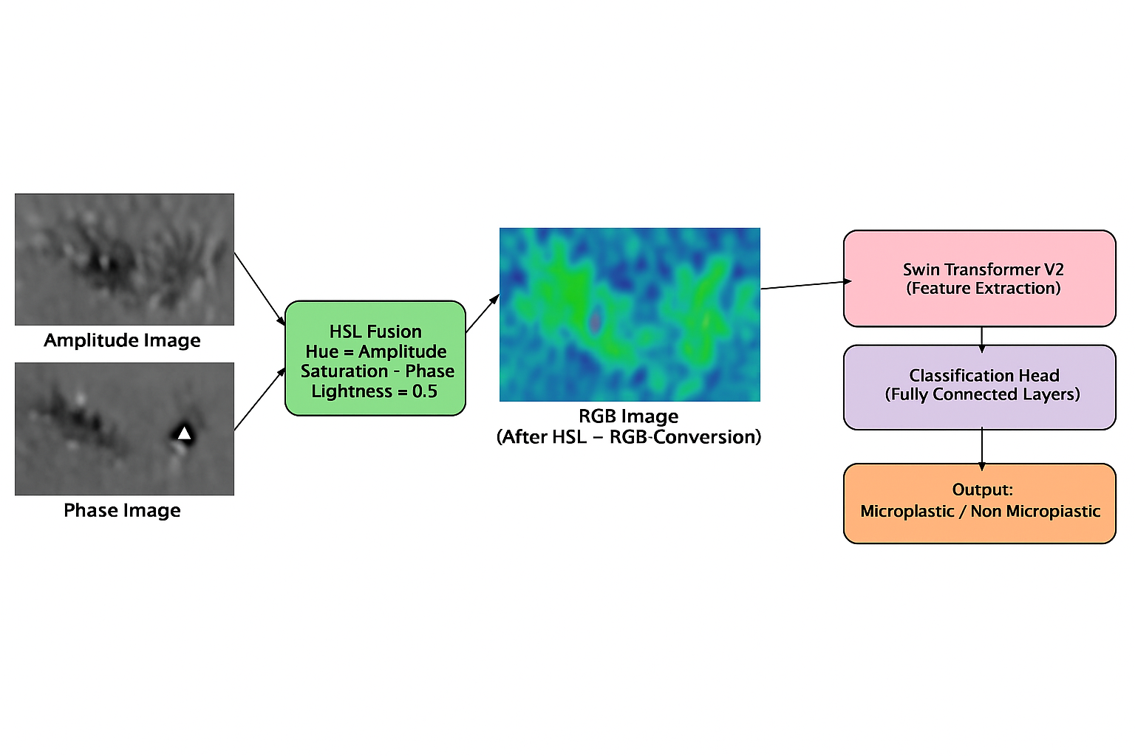
Proposed System Model
Overall Pipeline:
Input holographic amplitude & phase images.
HSL Fusion: H = A, S = P, L = 0.5 → converted to RGB format
Model: Swin Transformer V2 (hierarchical attention, shifted windows).
Data preprocessing: resizing (256×256), augmentation (flip, rotation, color jitter).
Output: binary classification (Microplastic / Non-Microplastic).

Slide 7
Simulation Setup
  System Configuration:
  Windows 10 OS
  Intel® Core™ i5 Processor
  8 GB RAM
  No dedicated GPU (CPU-based training)
  Development Environment:
  Language: Python
  Framework: PyTorch
  Libraries: timm, Albumentations, OpenCV
Dataset:
  HMPD dataset (2 classes)
  Includes image normalization and data augmentation (flips, rotations, brightness)

Slide 8
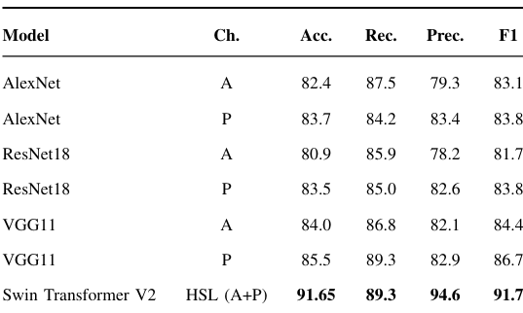
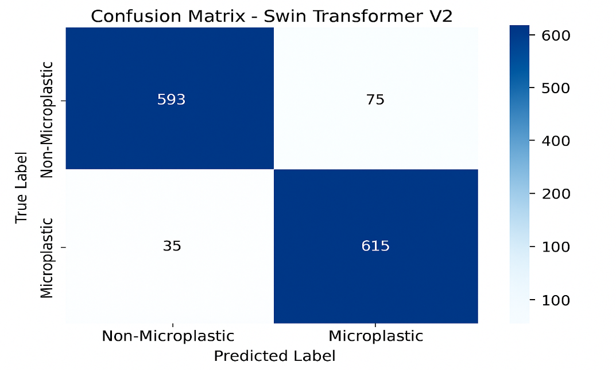
Result and Discussion
The proposed Swin Transformer V2 with HSL fusion efficiently combines amplitude and phase features, outperforming AlexNet, ResNet18, and VGG11 in microplastic classification.
The confusion matrix shows minimal misclassification between microplastic and non-microplastic classes.
Overall, Swin Transformer V2 provides efficient and accurate segmentation results.

Slide 9
Conclusion & Future Work
Conclusion:
HSL fusion effectively combines amplitude + phase holographic data.Achieves high accuracy and interpretability.
Swin Transformer V2 achieves state-of-the-art accuracy (91.65 %) on HMPD dataset.
Validates transformer applicability to microscopic image classification
Future Work:
Extend to multi-class microplastic types (fiber, fragment, pellet).
Test on real-world samples (field images).
Explore lightweight Swin variants for edge deployment.
Include hyperparameter optimization and cross-validation for reproducibility.

Slide 10
References
Z. Liu et al., “Swin Transformer V2: Scaling Up Capacity and Resolution,” Proceedings of the IEEE/CVF Conference on Computer Vision and Pattern Recognition (CVPR), pp. 12009–12019, 2022.
A. Dosovitskiy et al., “An Image is Worth 16×16 Words: Transformers for Image Recognition at Scale,” International Conference on Learning Representations (ICLR), 2021.
G. Russo et al., “Microplastic Classification in Holographic Images Using Swin Transformer V2,” Sensors, vol. 24, no. 5, pp. 1–17, 2024.
H. Chen et al., “A Survey on Vision Transformers in Computer Vision,” IEEE Transactions on Neural Networks and Learning Systems, vol. 35, no. 2, pp. 1550–1571, 2023.
J. Li et al., “Deep Learning for Microplastic Detection and Classification: Challenges and Perspectives,” Environmental Science & Technology, vol. 57, no. 6, pp. 2561–2574, 2023.
P. Zhang et al., “Attention Mechanisms in Environmental Image Analysis,” IEEE Access, vol. 11, pp. 12045–12059, 2023.

Slide 11
Reviewer Comments Addressed
All figures have been enhanced for better clarity and resolution.
A detailed comparison among different models has been added to strengthen the analysis.
Mathematical equations and architecture explanations are now clearly included.
Long paragraphs were split into shorter, well-structured sections for improved readability.
The experimental setup was refined and aligned with the formatting guidelines.
Dataset limitations and real-world deployment challenges were discussed in the Results section.
Grammar and language quality have been carefully revised for better clarity and flow.

Slide 12
Thank You

